Slide 1
TDD – Test Driven Development
E-Portfolio
By
Kai Schwark

Slide 2

Agenda
Why testing?
How do we test?
Now the other way round
Practice-Task
Conclusion

Slide 3
Why testing?
Changes
Be confident
Be safe
Proof of functionality
For you
For your client
Less maintenance-time
Less new bugs
Less time debugging

Slide 4
How do we test?
Formulate a wague idea of functionality
Write code
Test by hand
Correct found errors
Maybe write a test

Slide 5
How do we test? - UnitTests
Biggest cut of all the tests
Precice
Short
Only one usecase of a functunality of a function/class
No all-knowing miracle tests!

Slide 6
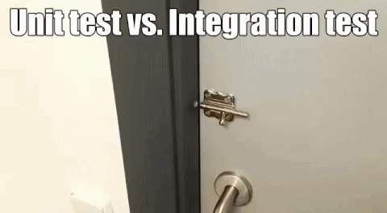
How do we test? – Only UnitTests?

Slide 7
How do we test? - IntegrationTests
Testing that seperately developed modules work together properly
Test that a system of multiple modules work as expected

Slide 8
How do we test? – useful conventions (For Me)
One test-class contains test for only one class that needs to be tested
The test-class should have the same name as the class to be tested with the Addition "Test" at the end (ex. MyClass -> MyClassTest)
Self-documenting names for tests. name of the tested function + testcase + expected outcome. (ex. "setSpeed_speedCanNotBeNegative_speedShouldBeUnchanged()").

Slide 9
How do we Test? - reminder
Write Code
Fix Errors
Write automated tests (eventually)

Slide 10
Now the other way round - TDD
Think what the Code should do
Write detailed tests for every use-case
Write Code against the tests

Slide 11
TDD - Benefits
Thinking before coding -> Improved productivity
Shorter implementation
Less unneeded code and redundancy
Easier debugging
100% test-coverage
Modularized, flexible & axtensible code
Easier documentation though self documenting tests

Slide 12
TDD – Limitations
Functional testing (ex. GUI design)
False sense of security (see unit- vs integration-test GIF)
Badly written tests cause maintenance overhead & blind spots

Slide 13
Practice-Task
Add a test that fails
Run tests & see if it fails
Write code to just pass the tests
Run all tests
Refactor the code

Slide 14
Conclusion
We’ve seen the benefits and limitations of TDD and now have an idea on how to start adopting and using the TDD approach at least partially in our projects to further increase the quality of our code.

Slide 15

Thank you for your time!

Slide 16
Sources
https://cdn-images-1.medium.com/max/1600/1*4-T6VVnULaszi9ydHQ7Sfw.gif
https://www.youtube.com/watch?v=QCif_-r8eK4
https://brainhub.eu/blog/test-driven-development-tdd/ (13.05.2019)
https://www.it-agile.de/wissen/agiles-engineering/testgetriebene-entwicklung-tdd/ (10.05.2019)
https://martinfowler.com/bliki/IntegrationTest.html (14.05.2019)

